Slide 1
MENG 372
Chapter 5
Analytical Position Synthesis
All figures taken from Design of Machinery, 3rd ed. Robert Norton 2003

Slide 2
5.1 Types of Kinematic Synthesis
Function Generation: correlation of an input function with an output function in a mechanism
Path Generation: control of a point in the plane such that it follows some prescribed path
Motion Generation: control of a line in the plane such that it assumes some sequential set of prescribed positions

Slide 3
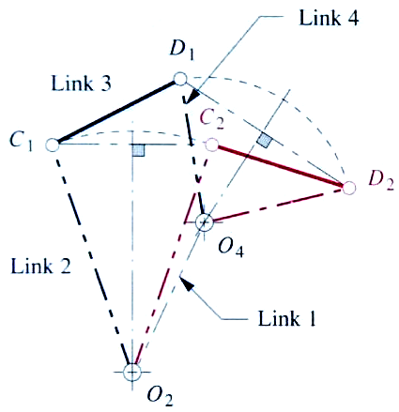
5.2 Precision Points
The points, positions prescribed for successive locations of the output (coupler or rocker) link in the plane.
In graphical synthesis: move from C₁D₁ to C₂D₂
In analytical synthesis: move from P₁ to P₂ while rotating coupler α₂ (note: angles are measured anticlockwise)
P₁
α₂
P₂

Slide 4
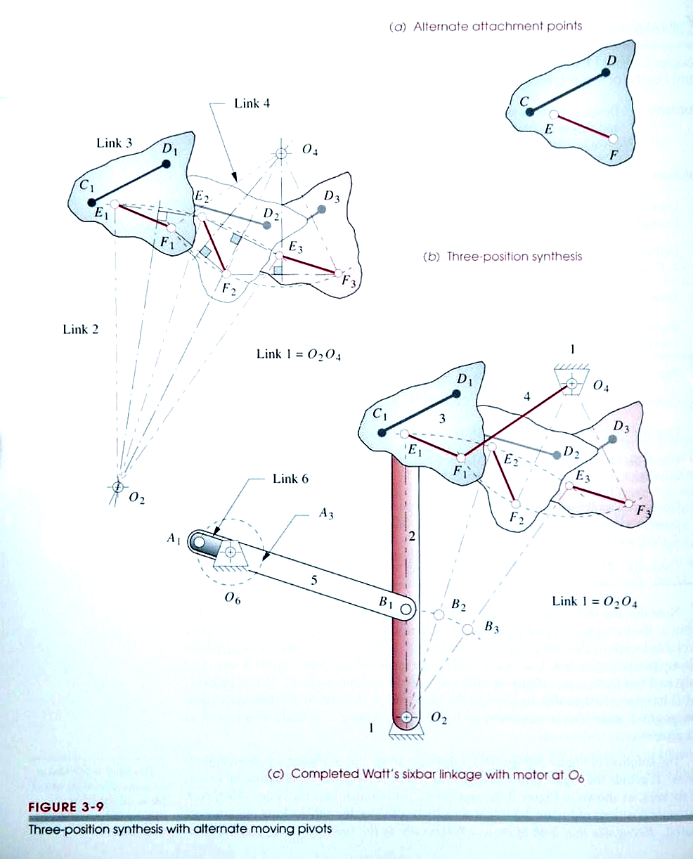
Precision Points
Can define vectors Z and S from the attachment points E and F to P
Note: the coupler is not triangular, but 3 points are defined on the coupler
Points E and F are called A and B
P₁
α₂
Z₁
S₁
P₂
A
B

Slide 5
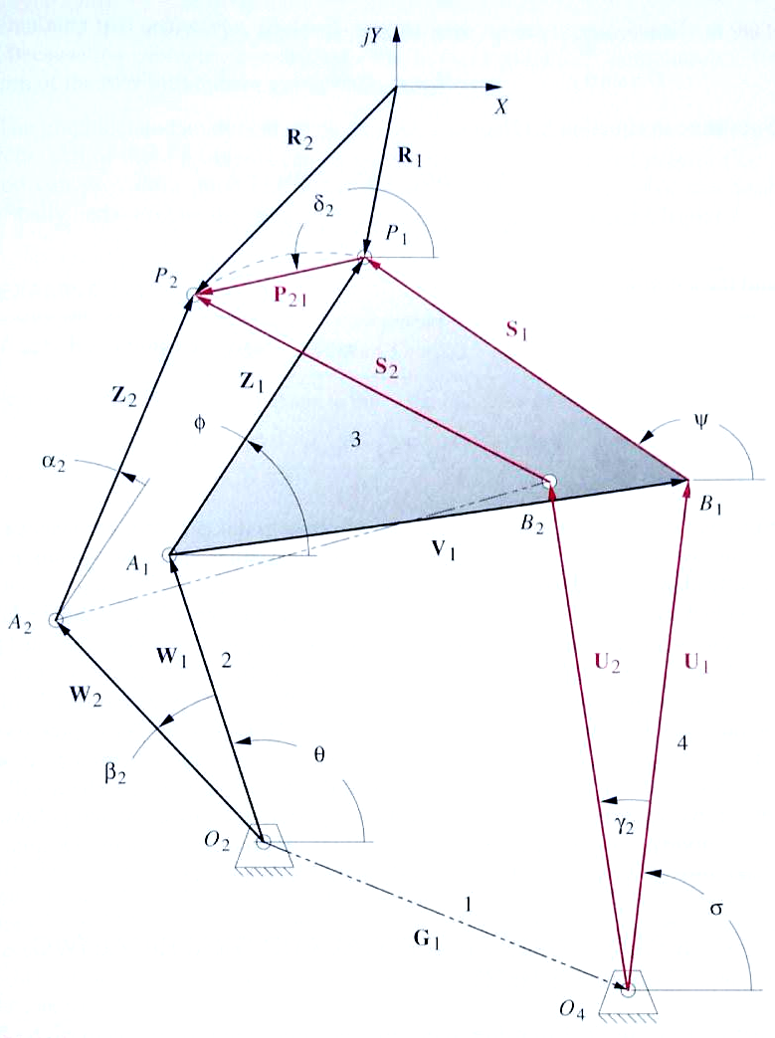
5.3 Two Position Synthesis
Want to move from P₁ to P₂ while coupler rotates α₂
Given P₂₁, δ₂ and α₂
Design each half separately
Write vector loop equation(s) to include given values, find free choices to make problem easy to solve.

Slide 6
Problem Statement
Y
Design a 4-bar linkage which will move P₁ to P₂ while coupler rotates thru ₂. P lies on coupler. Find the lengths and angles of all links.
X
R₂
R₁
Choose any coordinate system X-Y
Draw vector P₂₁ inclined at ₂
Define position vectors R₁ and R₂
Draw an arbitrary vector Z₁. Then form vector Z₂ with same magnitude but angle ₂ with Z₁.
Draw vectors W₁ and W₂ to meet at O₂.
Write vector loop equation.
₂
P₂
P₁
P₂₁
Z₁
Z₂

W₁
W₂
O₂

Slide 7
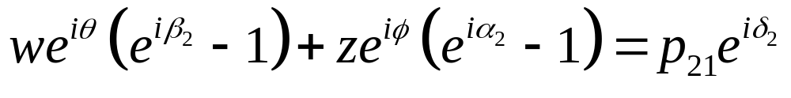
Two Position Synthesis
Vector loop equation
W₂ + Z₂ - P₂₁ - Z₁ - W₁ = 0
Write complex vectors
Expand exponents
Combine terms

Slide 8
Two Position Synthesis
Variables
w, θ, β₂, z, φ, α₂, P₂₁, δ₂ = 8
Given
P₂₁, δ₂, α₂ =-3
Complex equations: 1
can solve for 2 unknowns =-2
Free Choices =3

Slide 9
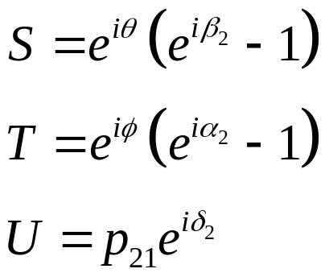
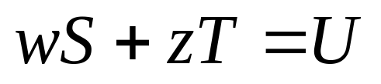
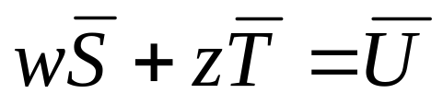
Two Position Synthesis
Choose (θ, β₂, φ)
Gives 2 simultaneous eqns.

Slide 10
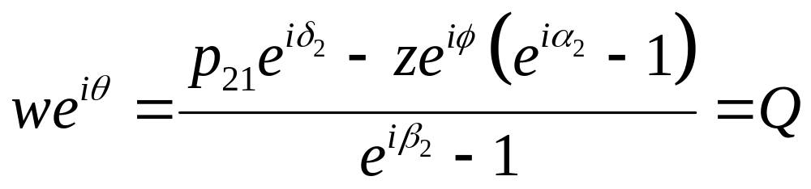
Two Position Synthesis
Choose (β₂, z, φ)
from which the magnitude and angle can be calculated
w=abs(Q), θ=angle(Q)
The other side can be calculated similarly

Slide 11
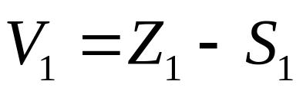
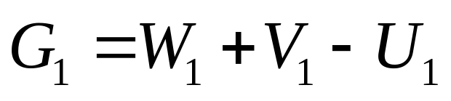
Two Position Synthesis
Once both sides have been solved, the coupler and ground can be calculated using
v=abs(V₁)
g=abs(G₁)

Slide 12
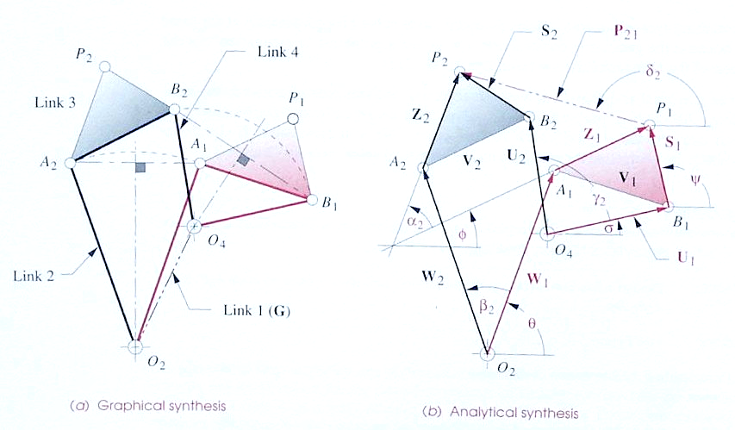
Two Position Synthesis Comparison
For graphical, position of attachment points A and B relative to P in x and y directions (4) and points of O₂ and O₄ along the perpendicular bisectors (2) gives 6 total
For analytical, 3 free choices each side * 2 sides=6 total

Slide 13
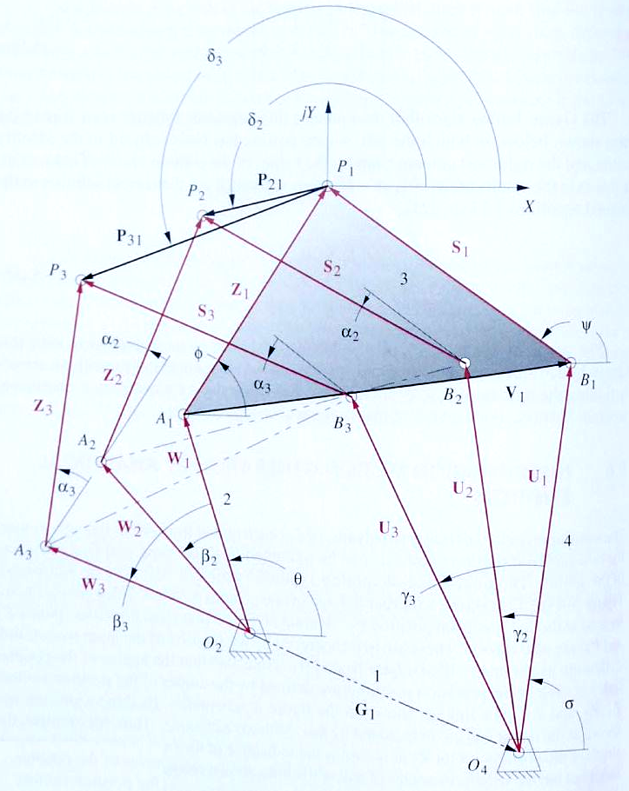
5.6 Three Position Synthesis
Want to move from P₁ to P₂ while coupler rotates α₂ and from P₁ to P₃ while coupler rotates α₃
Given P₂₁, δ₂, P₃₁, δ₃, α₂ and α₃.

Slide 14
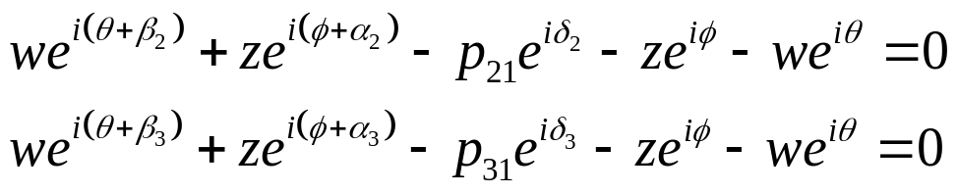
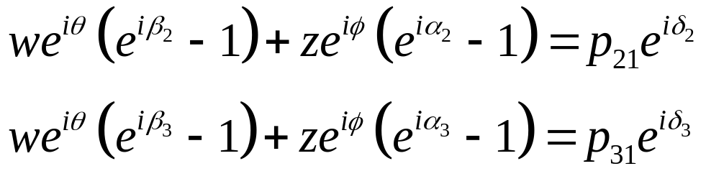
Three Position Synthesis
Vector loop equations
W₂ + Z₂ - P₂₁ - Z₁ - W₁ = 0
W₃ + Z₃ - P₃₁ - Z₁ - W₁ = 0
Write complex vectors
Combine terms
.

Slide 15
Three Position Synthesis
Variables
w,θ,β₂,β₃,z,φ,α₂,α₃,P₂₁, P₃₁, δ₂ ,δ₃ = 12
Given
P₂₁,P₃₁,δ₂,δ₃,α₂,α₃ =-6
Complex equations *2
2*2 =-4
Free Choices =2

Slide 16
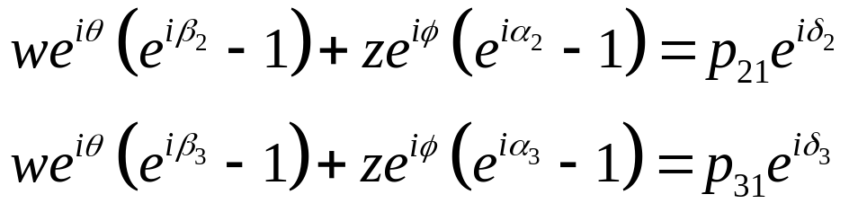
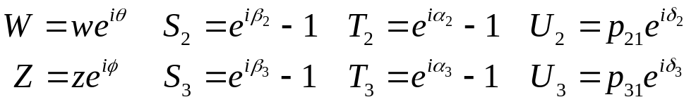
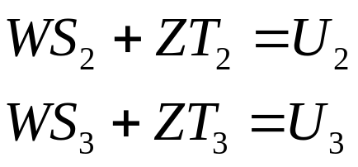
Three Position Synthesis
Choose (β₂, β₃ )
Two linear equations
Gives solution
w=abs(W), θ=angle(W)
z=abs(Z), φ=angle(Z)
.

Slide 17
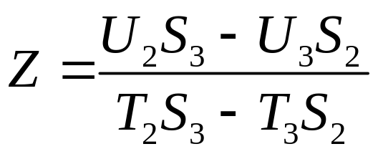
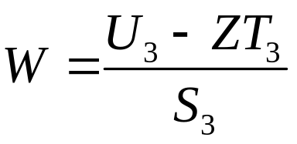
Solution
Eliminate W to get:
Then solve for W:
(USE MATLAB)

Slide 18
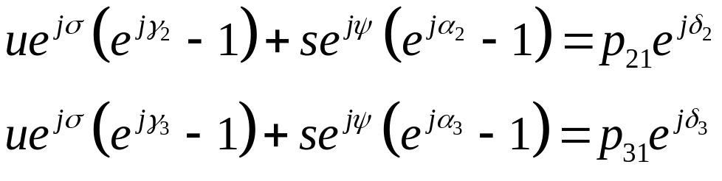
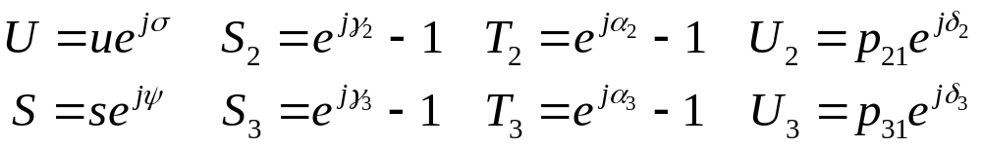
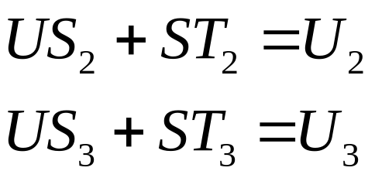
REPEAT FOR RIGHT-HAND SIDE OF LINKAGE
Choose (γ₂, γ₃ )
Two linear equations
(USE MATLAB)

Slide 19
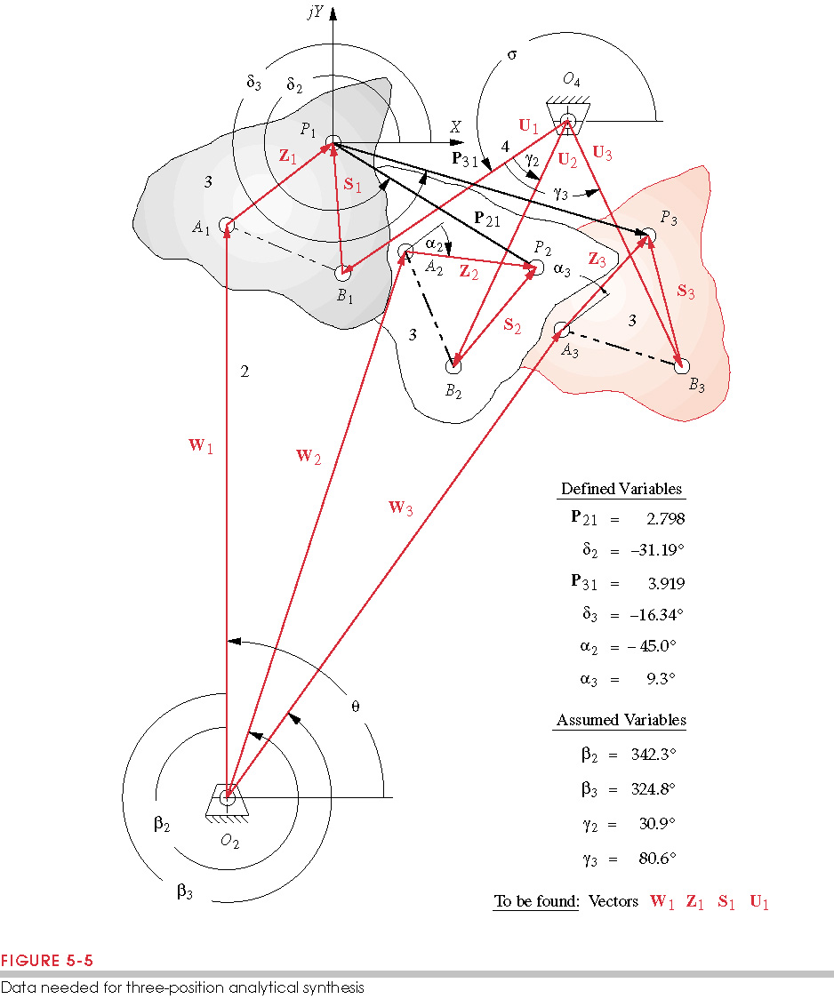
Three Position Synthesis Comparison
For graphical, position of attachment points A and B relative to P in x and y directions (4)
For analytical, 2 free choices each side * 2 sides=4 total

Slide 20
Example
Design a 4-bar linkage to move A₁P₁ to A₂P₂ to A₃P₃

Slide 21
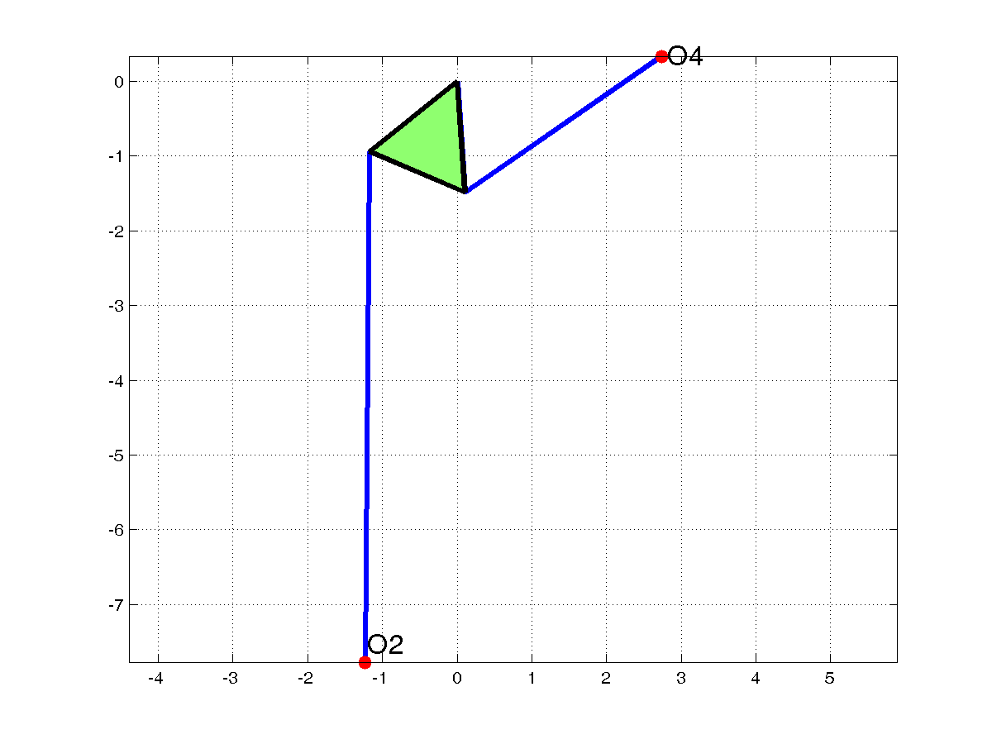

Slide 22
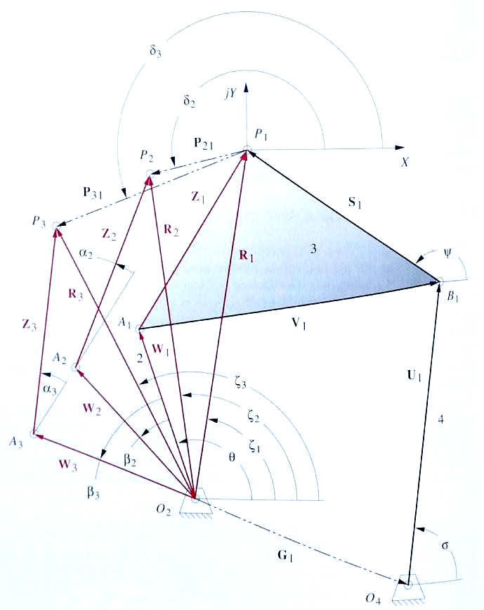
3 Position Synthesis with Specified Fixed Pivots .
Want to move from P₁ to P₂ while coupler rotates α₂ and from P₁ to P₃ while coupler rotates α₃ and attach to ground at O₂ and O₄
Given R₁,R₂,R₃,ζ₁,ζ₂, ζ₃, α₂ and α₃
Note: if R₁ and R₂ are satisfied, P₂₁ is satisfied, and R₁ and R₃ give P₃₁
φ

Slide 23

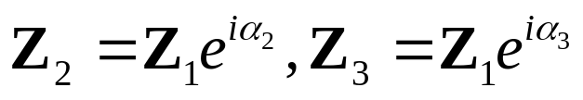
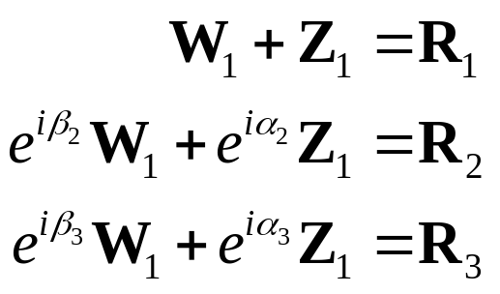
3 Position Synthesis with Specified Fixed Pivots .
Vector loop equations
W₁+Z₁=R₁
W₂+Z₂=R₂
W₃+Z₃=R₃
Use relationships
to get
φ

Slide 24
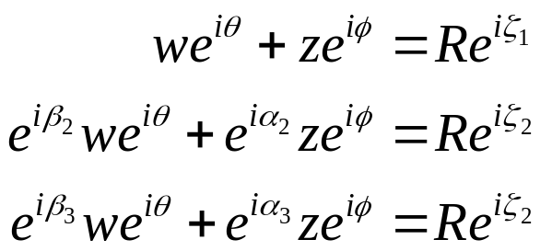
3 Position Synthesis with Specified Fixed Pivots .
Variables
w,θ,β₂,β₃,z,φ,α₂,α₃ ,R,ζ₁,ζ₂,ζ₃ = 12
Given
R,ζ₁,ζ₂,ζ₃,α₂,α₃ =-6
Complex equations *2
3eqn*2 =-6
Free Choices (Sub) =0
φ
This makes the problem hard

Slide 25

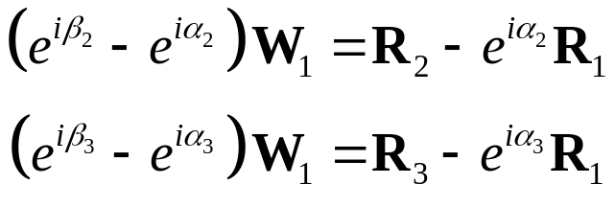
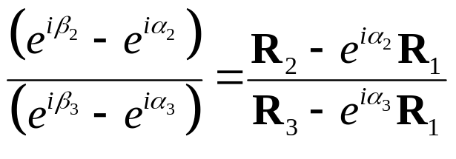
3 Position Synthesis with Specified Fixed Pivots .
From 1st equation:
Use this to eliminate Z₁
Divide 2 eq’ns to eliminate W₁
Cross Multiply

Slide 26
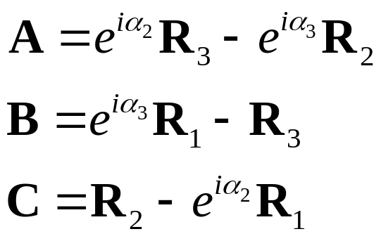


3 Position Synthesis with Specified Fixed Pivots .
Arrange into form
where
using s and t:
gives
A
+
B
e
i
β
2
+
C
e
i
β
3
=
0

Slide 27

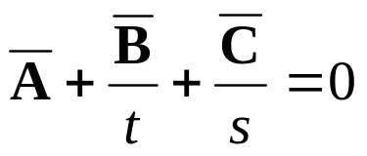
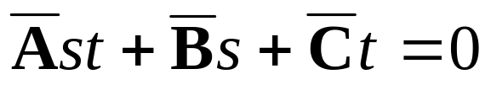
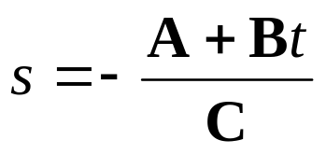
3 Position Synthesis with Specified Fixed Pivots .
(a)
Taking conjugate
Since s and t represent angles
Multiplying by st
From (a)
Substituting into (b) gives a quadratic function of only t
(b)

Slide 28

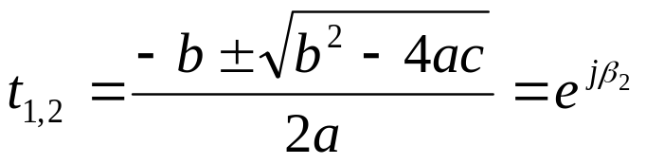
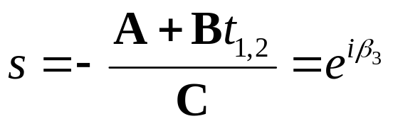
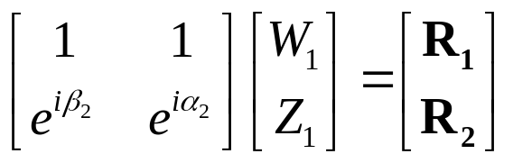
3 Position Synthesis with Specified Fixed Pivots .
where
Solving gives
Only one of the t will be valid. s can be solved using
Any 2 of the first eqns can be used to solve for W₁ and Z₁

Slide 29

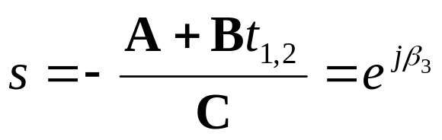
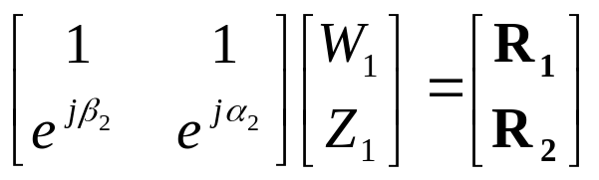
3 Position Synthesis with Specified Fixed Pivots .
Summary of calculations (for MATLAB implementation)
w=abs(W₁), θ=angle(W₁), z=abs(Z₁), φ=angle(Z₁)

Slide 30
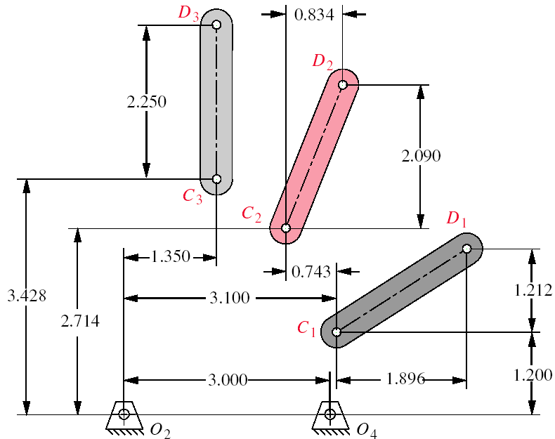
Example Problem
Move from C₁D₁ to C₂D₂ to C₃D₃ using attachment points O₂ and O₃
Call point C, P
φ₃
φ₂
φ₁

